Slide 1
Which Airbnb Reigns Supreme?
By David Larson, Nick Gapinski, Sheikh Fahad
Notes:
All

Slide 2
How we filtered the data set
Facets:
Room Type : Entire Apartment / House
Bedroom : 2 / 3
Minimum Nights : 1 / 2
Review Scores Rating : 95-100
Number of reviews : ≥100
New Columns:
Kitchen : True (if kitchen in description) / False (if not mentioned)
Lake : True (if lake in description) / False (if not mentioned)
Notes:
David

Slide 3
Our Final 8 Host List After Filtering
Becky (Minneapolis)
Colleen & Aaron (Minneapolis)
Jane (Minneapolis)
Jerry (Minneapolis)
Patrick (Minneapolis)
Renee, Tom and Marvis (Minneapolis)
Stuart (White Bear Lake)
Suzann (White Bear Lake)
Notes:
David

Slide 4
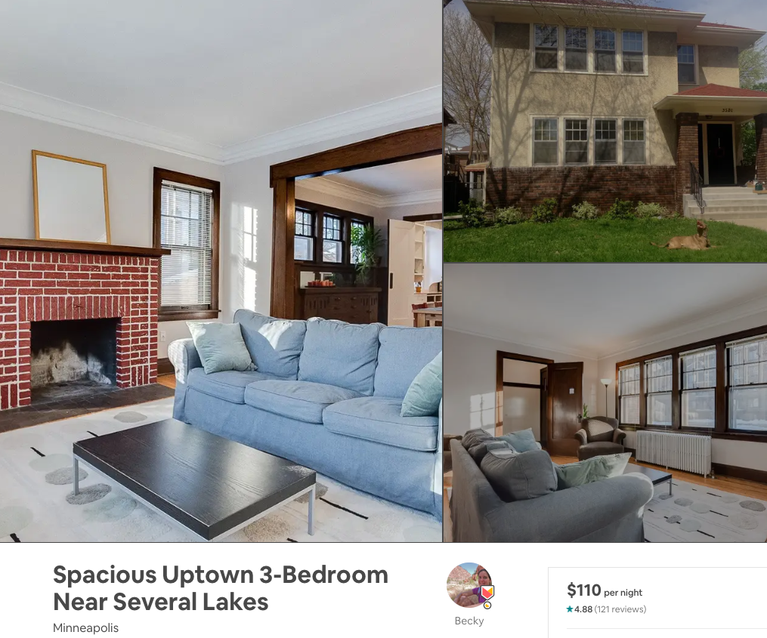
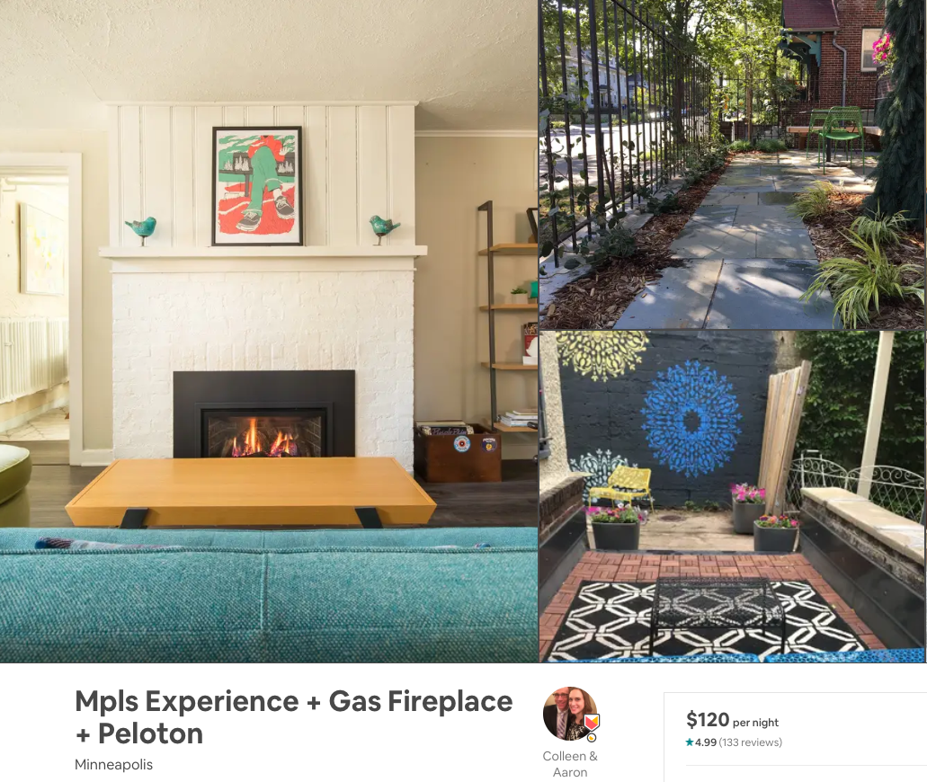
Becky | Colleen and Aaron
Notes:
Nick

Slide 5
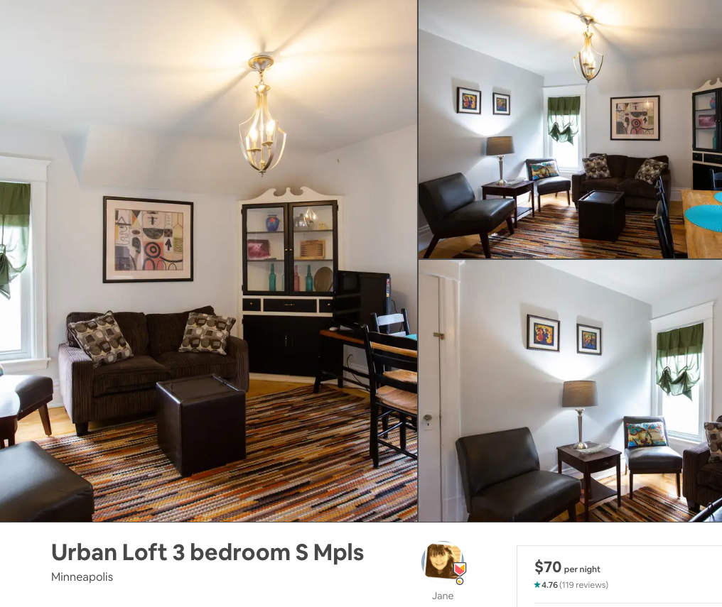
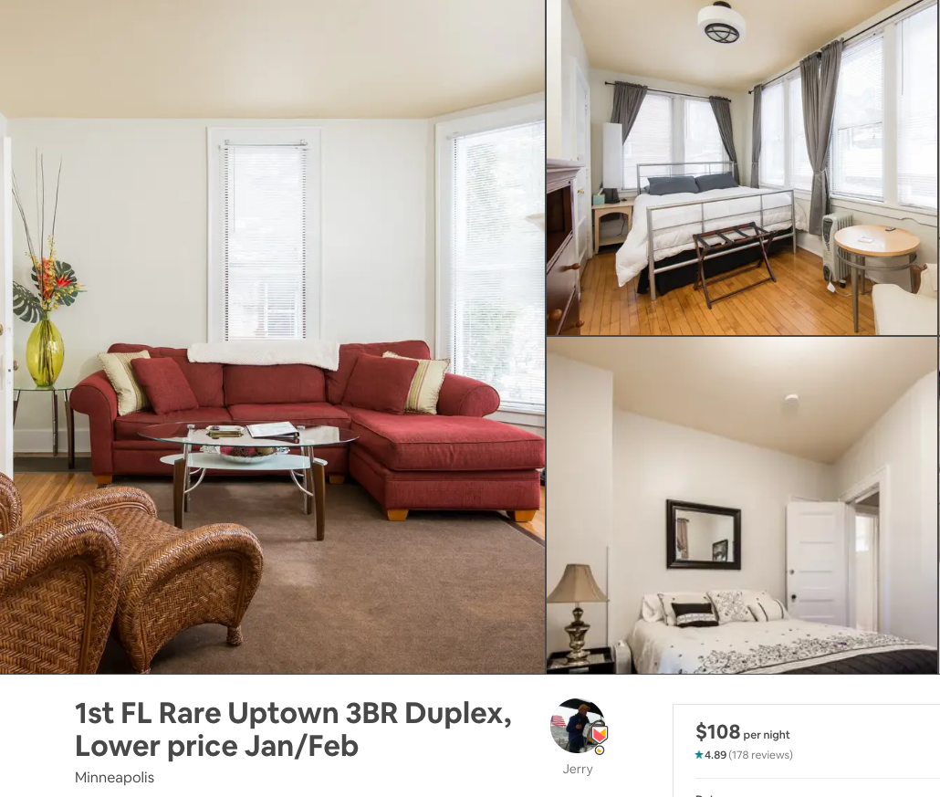
Jane | Jerry
Notes:
Nick

Slide 6
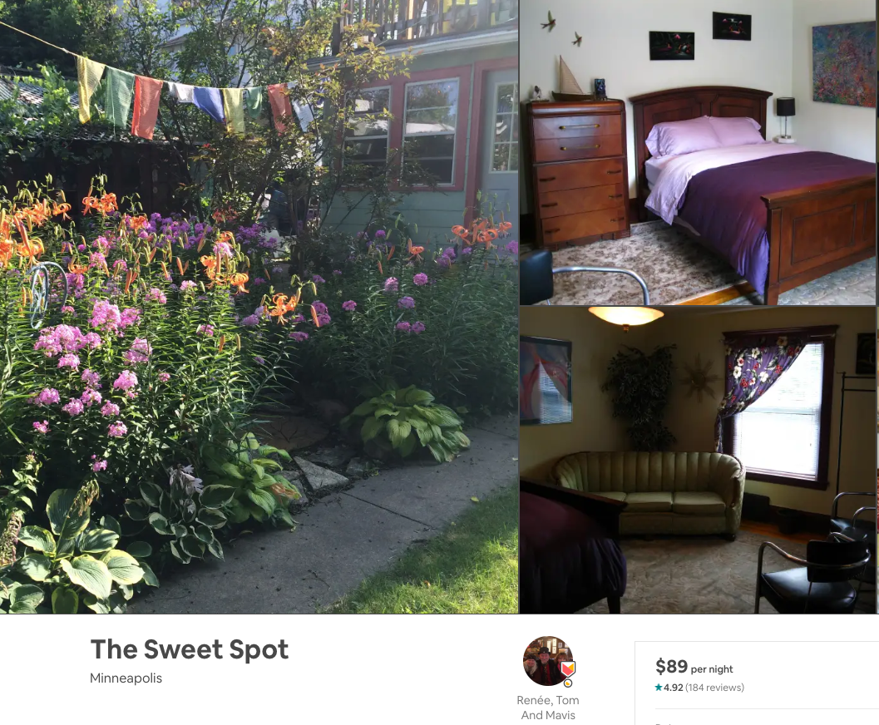
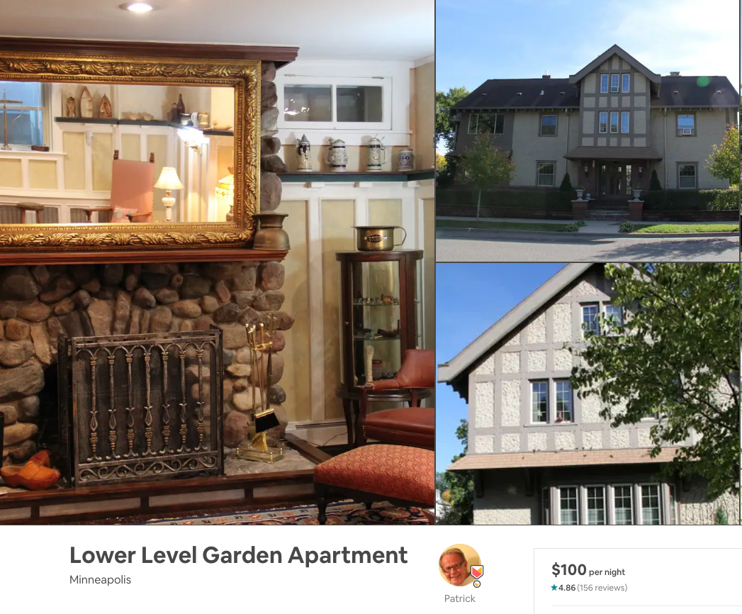
Patrick | Renee
Notes:
Nick

Slide 7
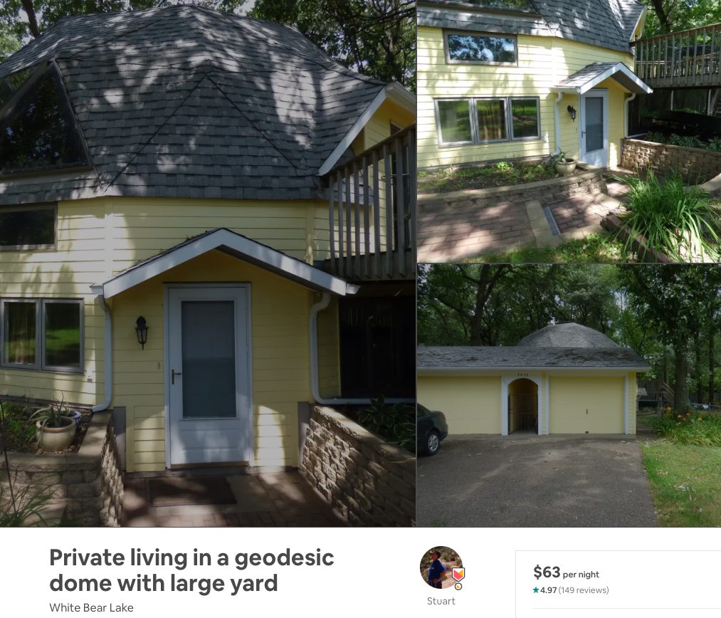
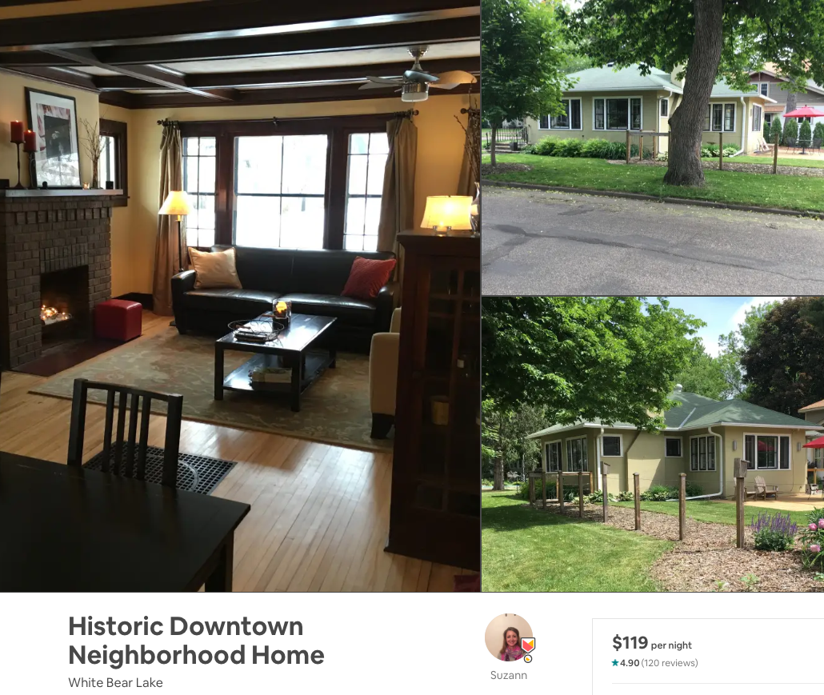
Stuart | Suzann
Notes:
Nick

Slide 8
Point System to Determine Best Value
Bedrooms
2 bedrooms: +0 points
3 bedrooms: +2 Point
Review Scores Rating
95-96 : +1 point
97-98 : +2 points
99-100 : +3 points
Number of reviews
<120 : +0 points
120-139 : +1 point
140-159 : +2 points
160-179 : +3 points
>180 : +4 points
Child Friendly
Near Lake: +2 point
Lake with swimming/activities : +2 points
Near Park: +1 point
Child Friendly Park: +2 points
Price ($)
>111 : 0 points
101-110 : +1 point
91-100 : +2 points
81-90 : +3 points
<80 : +4 points
Scores will be out of 20 total points
Notes:
Fahad

Slide 9
Which host has best value?
(Host name) (Score)
Becky - 13
Colleen & Aaron - 5
Jane - 9
Jerry - 15
Patrick - 7
Renee, Tom and Marvis - 11
Stuart - 10
Suzann -10
Notes:
Fahad

Slide 10
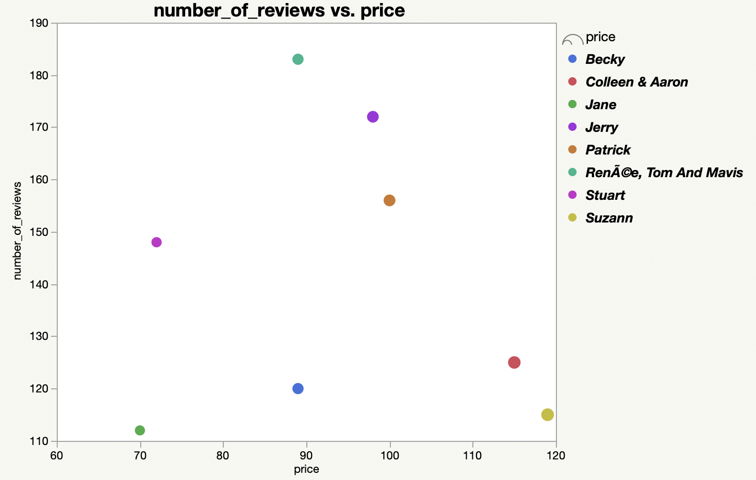
Graphing Review Scores vs. Daily Price
Graph Criteria
Color: Host name
Size: Price
X-axis: Price
Y-axis: Number of Reviews
Does this graph help us eliminate anything? Nope.
Notes:
Nick

Slide 11
From 8 to 5
But Why?
Becky
Colleen & Aaron
Jane
Jerry
Patrick
Renee, Tom and Marvis
Stuart
Suzann
None of these houses are within walking distance to a lake
No parks
Not very child friendly
Bottom 3 in terms of value
Notes:
David

Slide 12
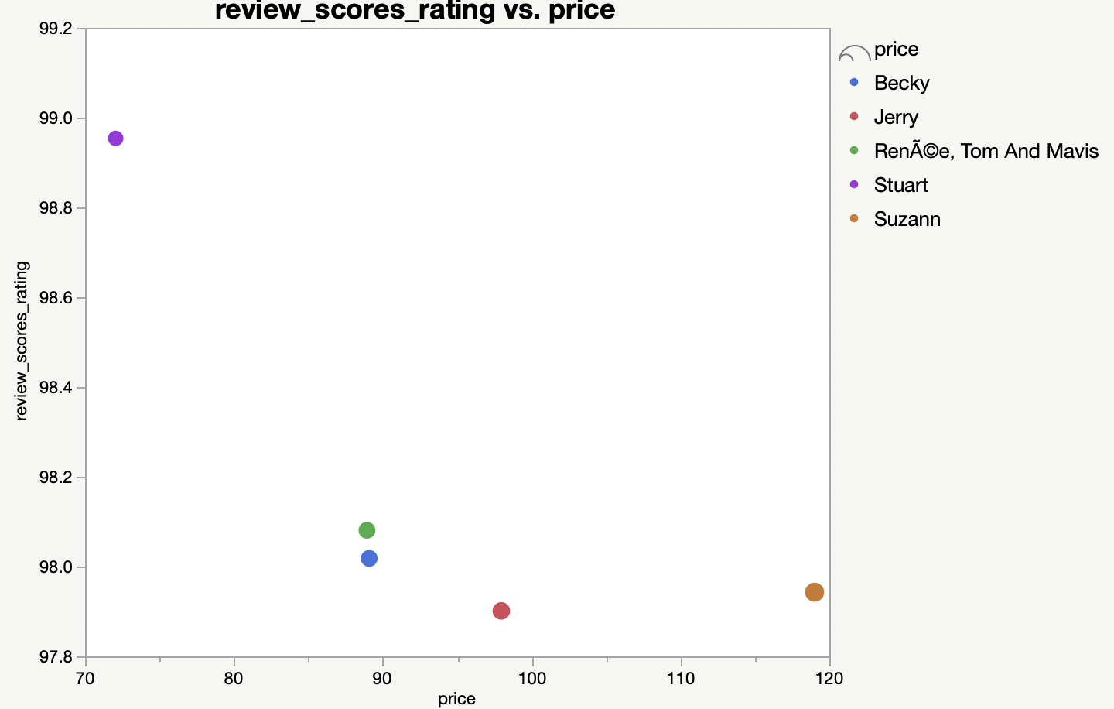
Final 5: Review Ratings vs. Per Day Price
Graph Criteria
Overlay: Host name
Size: Number of Reviews
X-Group: # of Bedrooms
Who’s the outlier?
Notes:
Nick

Slide 13
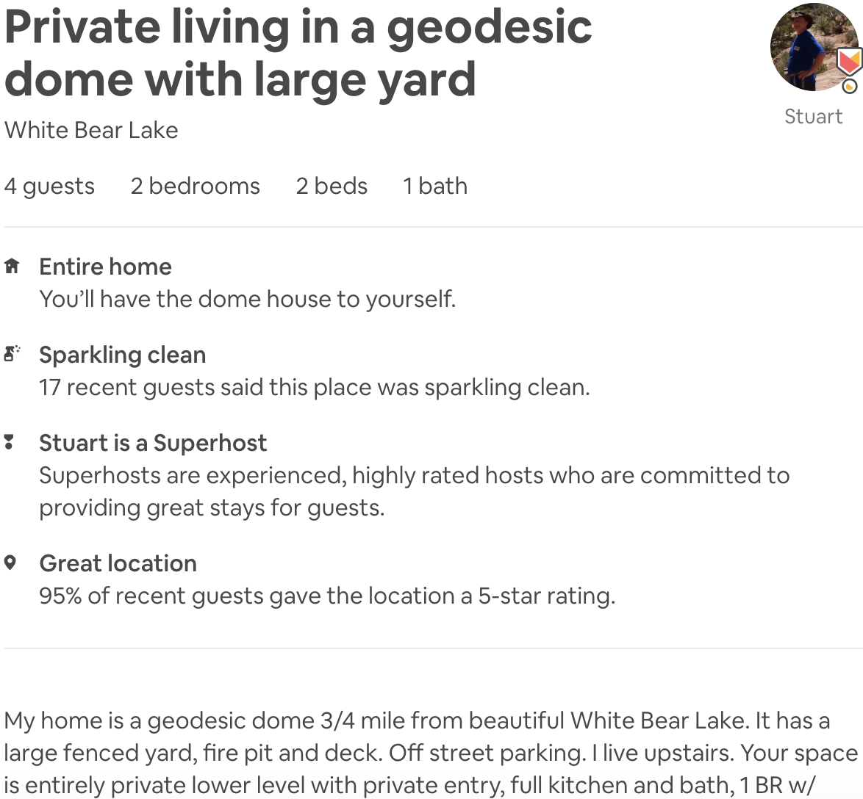
The Geodesic Dome!
After reviewing his Airbnb page, we noticed something….
He lied on his listing. So due to this, the Geodome is out.
Notes:
Fahad

Slide 14
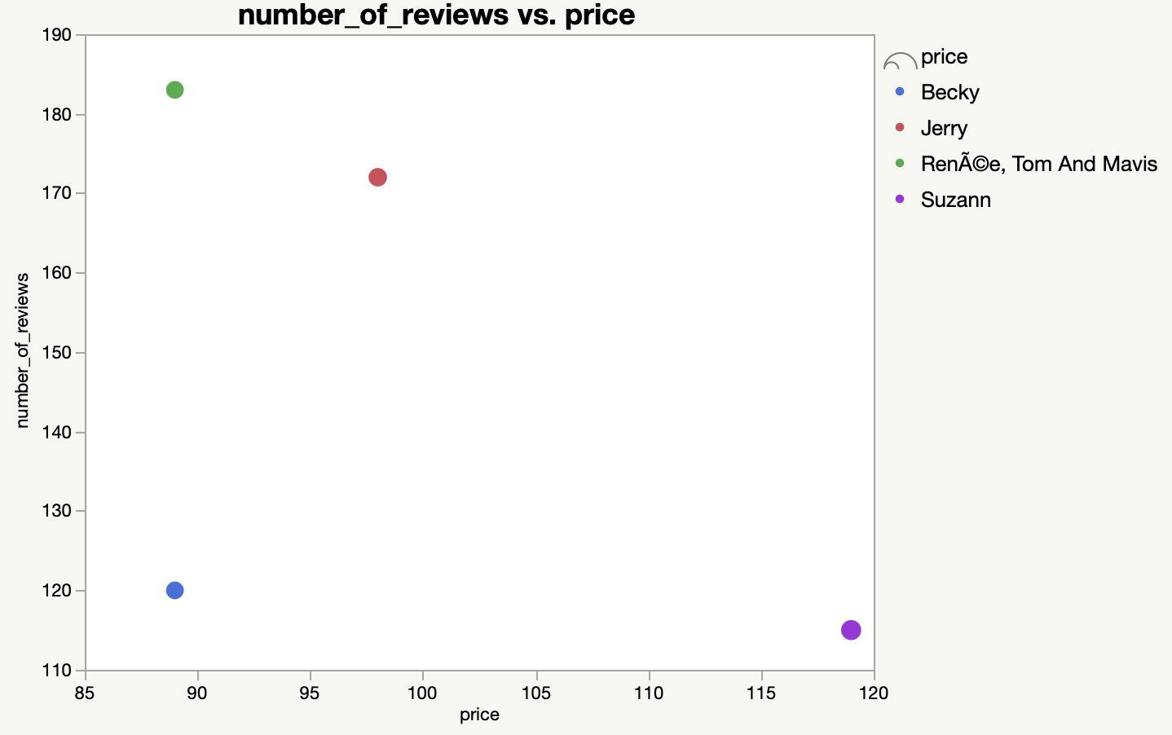
Goodbye Suzann
Based on this graph we decided against her Airbnb, reason being that her price was much higher than the average.
Notes:
Nick

Slide 15
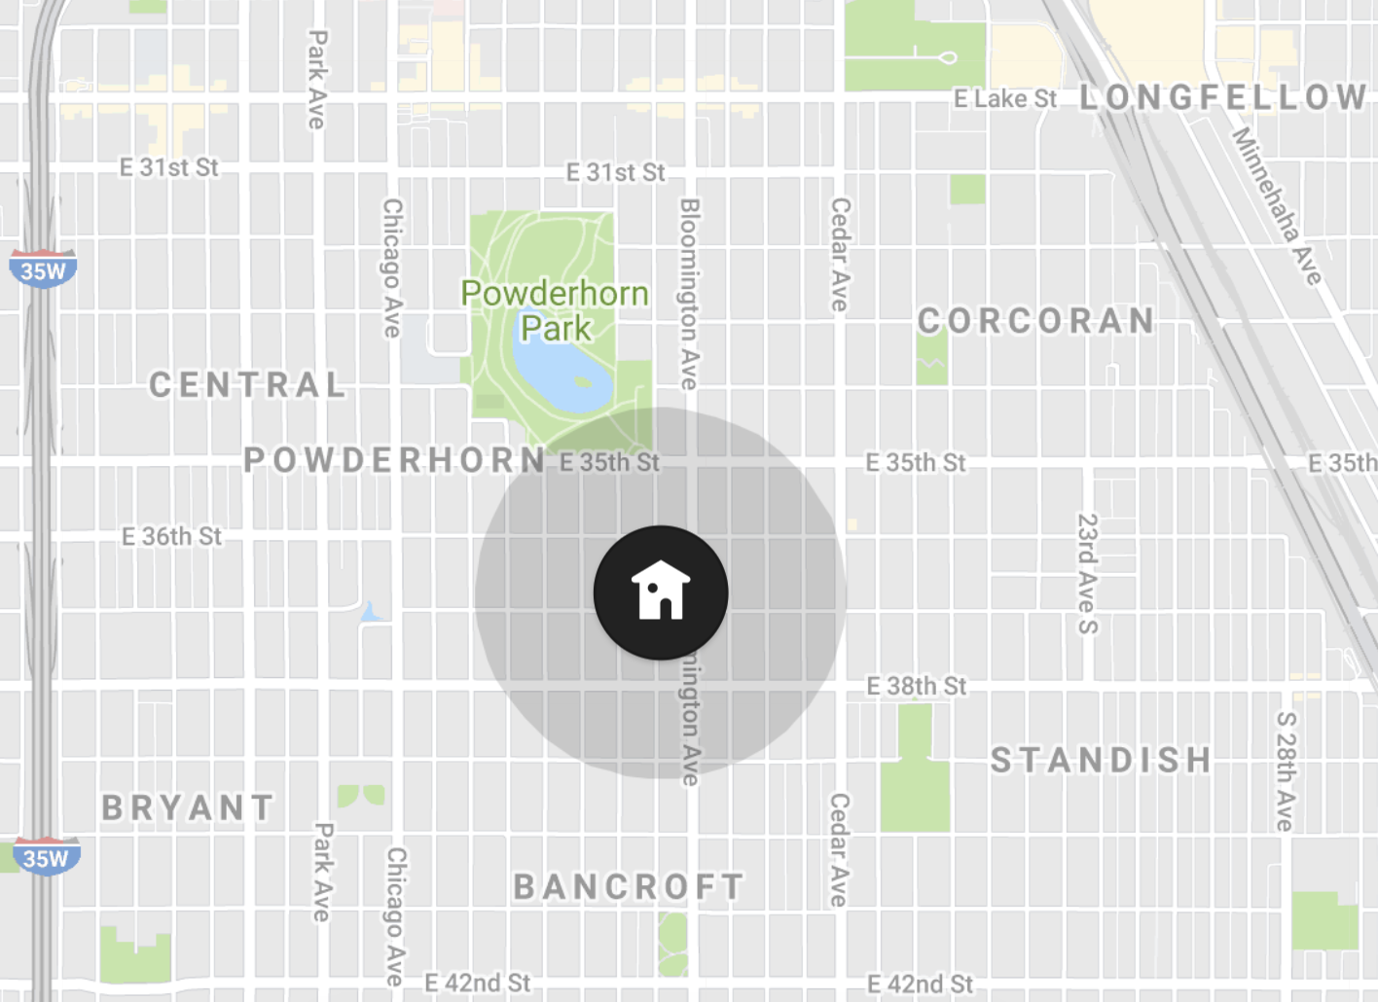
Eliminating Renee’s House
Her location ended up being her downfall.
The lake she is near is very dirty (no swimming 😢 )
The park is just walking paths through a forested area, so not very kid-friendly
Notes:
David

Slide 16
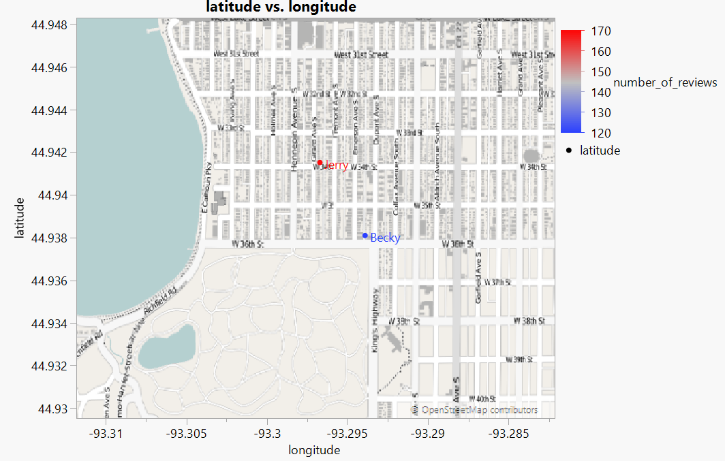
Final Comparison | Becky vs. Jerry
Each house is located in the same neighborhood
Review scores are nearly identical (0.01 difference)
Jerry has more reviews
Price is $1 different per night
Test scores
Jerry (15)
Becky (13)
Notes:
Fahad

Slide 17
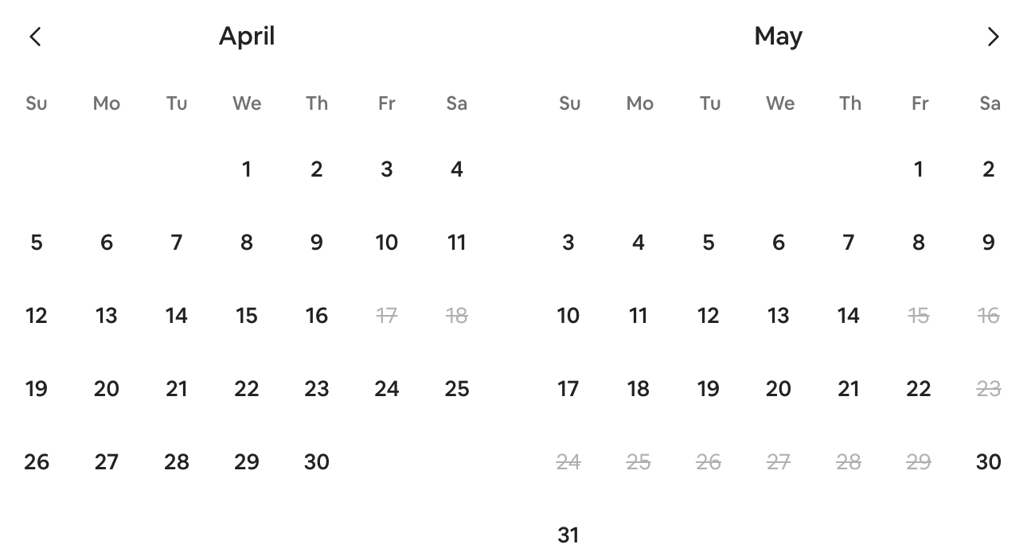
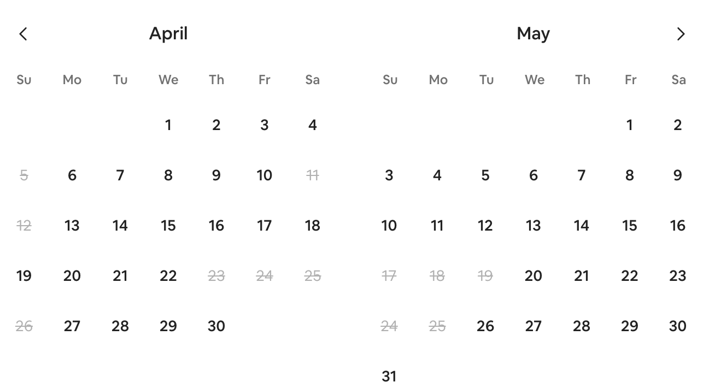
How in-demand are our hosts?
Becky
Jerry
Available Weekends: Apr 3-4th , 10-11th, 24-25th,
May 8-9th
Available Weekends: Apr 3-4th, 17-18th
May (all of them)
Notes:
Nick

Slide 18
So what is our final decision?

Slide 19

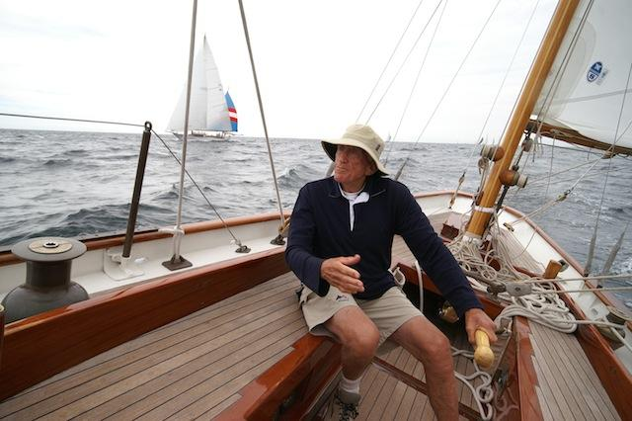


Jerry sails to the finish line!
note: Jerry is a small business owner and part-time sailor
Notes:
All

Slide 20
Ranking our Hosts
Jerry
Becky
Renee
Suzann
Stuart
Jane
Patrick
Colleen
Notes:
All

Slide 21
Our random discovery
2870 airbnbs in the data set had a maximum number of nights of 1125. That’s over three years!!!
Total prices ranged from $11,250 ($10 a night) to as much as $11,250,000 ($10,000 a night) for the entire three years!
Notes:
All

Slide 22
Links to our top hosts
https://www.airbnb.com/rooms/18841569?source_impression_id=p3_1582491544_ibfMkTkPios3RKI1 (1) (Becky)
https://www.airbnb.com/rooms/7327750?source_impression_id=p3_1582489890_wteDZCM7VS0w%2Bx7w (2) (Jerry)
https://www.airbnb.com/rooms/10672305?source_impression_id=p3_1582489741_4zcZbsOQYWkUbgqt (3) (Suzann)
https://www.airbnb.com/rooms/3277237?source_impression_id=p3_1582491533_WILZLgl%2BWlxIwT4X (4) (RenEe)
https://www.airbnb.com/rooms/14283781?source_impression_id=p3_1582491653_IVpeuxubgbFIviYp (5) (Stuart)
https://www.airbnb.com/rooms/20976481?source_impression_id=p3_1582494341_BDS9T%2Fs%2BfqgG0eI%2B (Colleen)
https://www.airbnb.com/rooms/15173154?source_impression_id=p3_1582494350_z623feGT6JB%2BXsOk (Jane)
https://www.airbnb.com/rooms/1789183?source_impression_id=p3_1582494362_tAKQw9dZ9U%2FQXfRE (Patrick)
Notes:
None

